Slide 1

WEB APPLICATION
PROGRAMMING
WeatherInsights

Slide 2
WHAT WE ARE WORKING ON
DESIGN
DATA
CHART
Clean and intutive user interface design
Display data in real time
Different type of chart to compare the data

Slide 3
NOW
DASHBOARD
SIDEBAR MENU
ADAPTABILITY

Slide 4
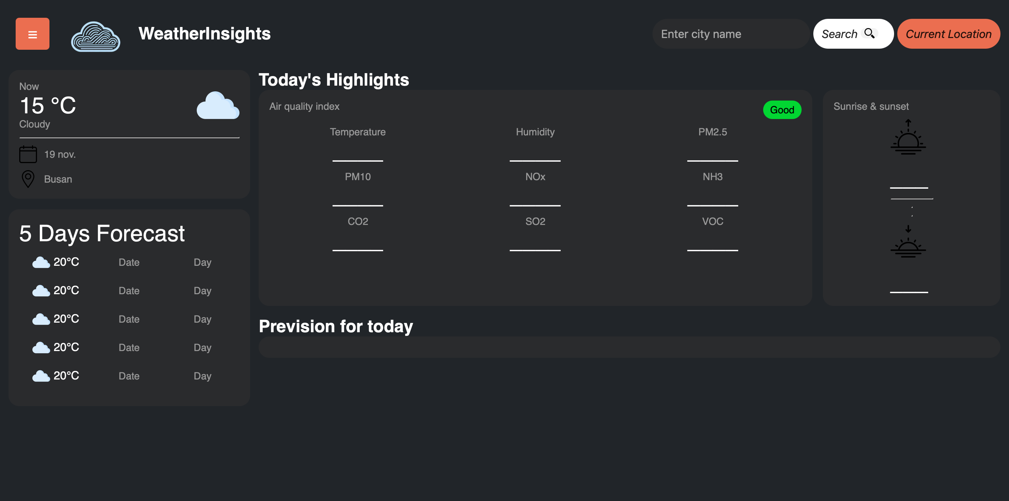
NOW

Slide 5
FUTURE
API
CHART
FEATURES

Slide 6

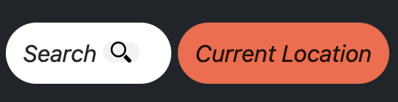
FUTURE FEATURES
USABILITY
Air quality display
Search & current Location Button

Slide 7
THANKS!
Does anyone have any question?
addyouremail@freepik.co

